Slide 1
Class 04 On Course: CS-103
VUCC
Conducted By:
Nakib Aman Turzo
Lecturer
Department of CSE
Varendra University

Slide 2
Google Sheets Advanced Features
VUCC
Add images to cells
To place an image straight into a cell type =image(“URL of the image you want to add”). There are a few options for inserting and formatting images:
=image(“URL of the image”,1) – image scaled to fit the cell
=image(“URL of the image”,2) – image stretched to fit the cell
=image(“URL of the image”,3) – image keeps its original size
=image(“URL of the image”,4) – image in a custom size

Slide 3
Create QR codes
VUCC
QR codes can be used for a number of reasons – including WiFi login, concert tickets, advertisements, and product purchases. Google Sheets lets you generate QR codes with any input you like. Just use the following formula:
=image(“https://chart.googleapis.com/chart?chs=150×150&cht=qr&chl=”&A2).
A2 is the cell with the URL or text you want to use to create your QR code.

Slide 4
Get only unique values from a column
VUCC
Use the function UNIQUE( ) to get a list of unique values from a range or column.

Slide 5
Web scraping with Google Sheets
You can access data from a website in your spreadsheet without having to copy and paste using the IMPORTHTML( ) or IMPORTXML( ) functions.
Copy the formula below into A1 and you’ll see the same data as the image below:
=IMPORTHTML(“https://en.wikipedia.org/wiki/List_of_highest-grossing_films”,”table“,1)
VUCC

Slide 6
Detect a language
VUCC
Google has a built-in language detector. Use the formula DETECTLANGUAGE( ) and it will return a two letter language code.
Full language list can be derived form the following link-
https://en.wikipedia.org/wiki/List_of_ISO_639-1_codes

Slide 7
Translate a language
VUCC
Google can detect a language but also translate from one language to another.
The formula GOOGLETRANSLATE( ) has three parts – text to translate, the current language of the text, and the language you want to translate into.

Slide 8
Check for valid emails and URLs
VUCC
The function ISEMAIL( ) checks to see if a string of text or cell has a valid email syntax.
The function ISURL( ) returns true or false if a string of text or cell has a valid URL.

Slide 9
Project future results with GROWTH( ) - 1
VUCC
The GROWTH( ) function can be used to extrapolate a trend and predict future values.
The image below shows the sales of a product over 5 periods. With the formula =growth(B1:B5,A1:A5,A7:A9) you can estimate what the values would be for 6 – 8.

Slide 10
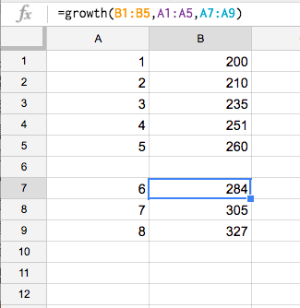
Project future results with GROWTH( ) - 2
VUCC

Slide 11
Pick randomly from a list
VUCC
The functions CHOOSE( ) AND RANDBETWEEN( ) help you pick a value from a defined list. RANDBETWEEN( ) generates a random integer between 1 and 5. CHOOSE( ) helps you pick from the list of entries.
=CHOOSE(RANDBETWEEN(1,5),”London”,”Berlin”,”Rome”,”Madrid”,”Lisbon”)

